Slide 1
Brief Intro to (Geo)spatial Data AFRE 891 Spring 2024 Modifed from “Overview of Geospatial Data” by Patty Frontiera, Drew Hart, and Hikari Murayama of UC Berkeley’s D-Lab Used under CC BY-NC-SA 4.0

Slide 2
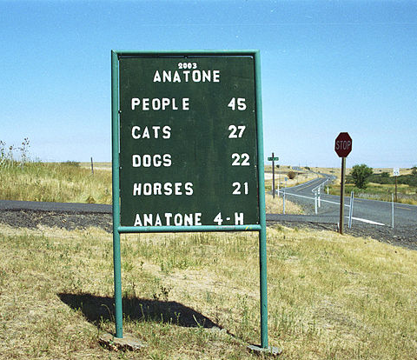
Geographic Data
A single unit of geographic data includes:
1. Location (where): Anatone 2. Attributes (what): data that describe the location
Also great to have metadata: When: 2003 Who: Anatone 4-H How: local census?
Notes:
Source: https://upload.wikimedia.org/wikipedia/commons/thumb/e/ee/Anatone_WA.jpg/640px-Anatone_WA.jpg
Geographic data, on the other hand, is data that could answer the questions “where” and “what”. In this example we have “Anatone, WA” as the where, and the what could be the data that describes the location (like this sign post).
Metadata in our context is specified as something that “[This standard] provides information about the identification, the extent, the quality, the spatial and temporal aspects, the content, the spatial reference, the portrayal, distribution, and other properties of digital geographic data and services.” (ISO 19115:2013 "Geographic Information – Metadata). In includes information about when the file was made, who made it, the geographic span, and more!

Slide 3
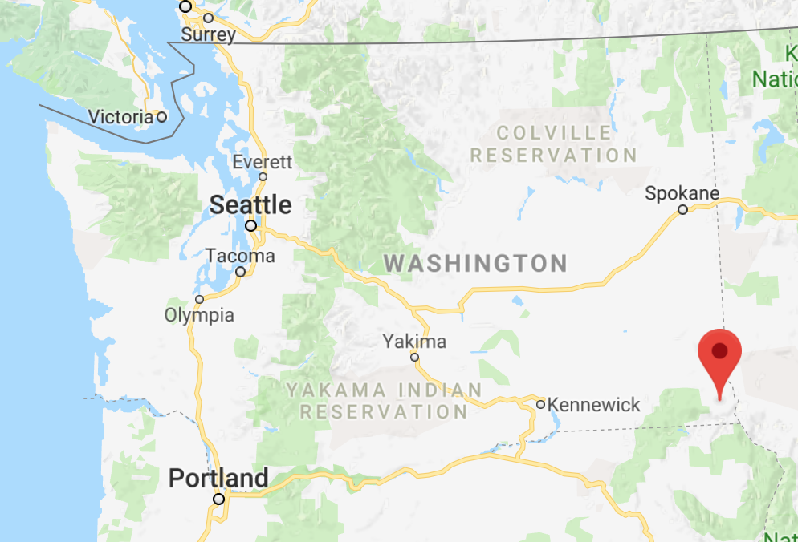
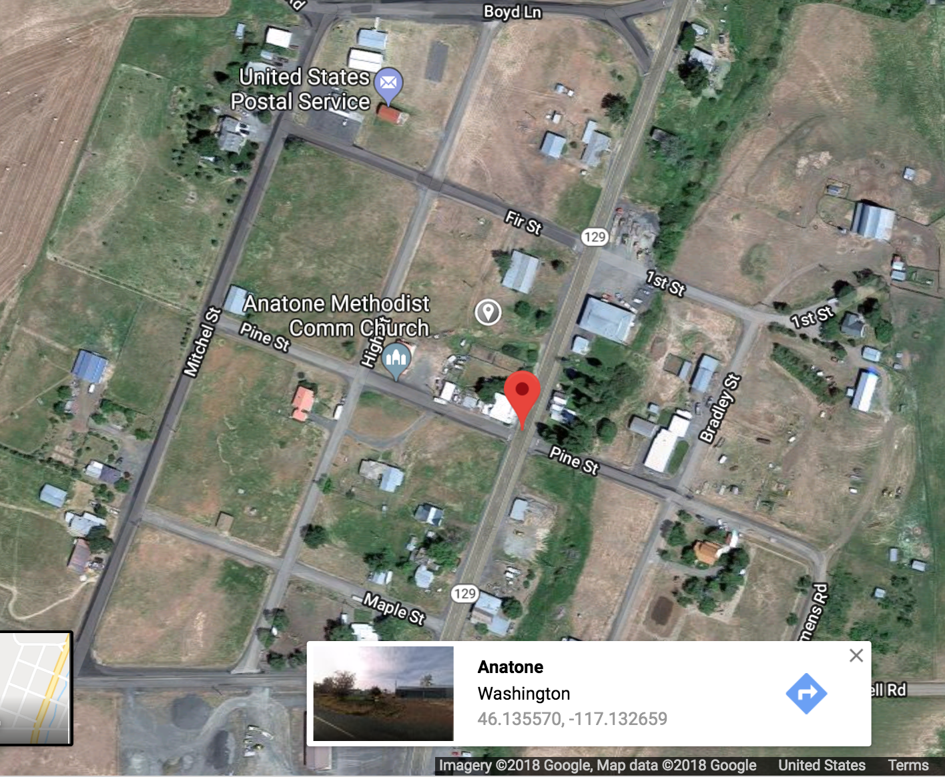
Geospatial Data
Encodes geographical location geometrically with coordinates
Anatone, WA: 46.130479, -117.134167
Challenge: how do we know that those coordinates reference this specific location?
Notes:
So Geospatial Data is a location that is given by a set of coordinates. Anatone WA has specific coordinates associated with its location, a latitude and a longitude. The specific values we use to answer the question of “where” can differ by the coordinate reference system we use.

Slide 4
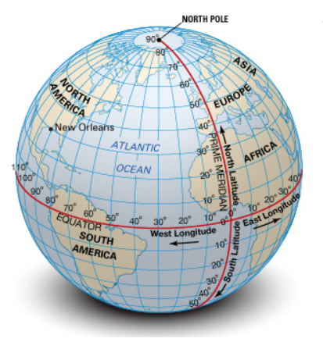
Coordinate Reference System (CRS)
Challenge: how do we know that those coordinates reference the desired location?
Solution: Coordinate Reference System (CRS)
System for associating coordinates with a specific, unambiguous location on the earth’s surface
New Orleans = 30N, 90W
Notes:
So Geospatial Data is a location that is given by a set of coordinates. Anatone WA has specific coordinates associated with its location, a latitude and a longitude. The specific values we use to answer the question of “where” can differ by the coordinate reference system we use.

Slide 5
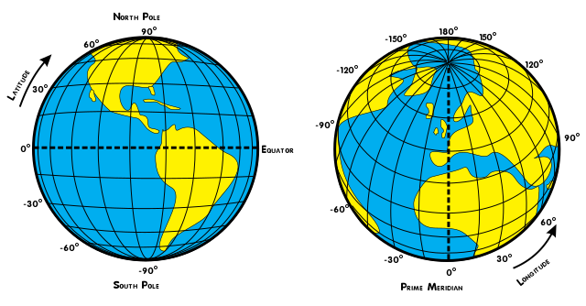
Coordinate Reference System (CRS)
Geographic coordinates: Latitude and Longitude pair
http://latitude-longitude.net
Notes:
These latitude and longitude pairs are what make make geometries geographies! With this pair of numbers you can point to a specific point on the globe.

Slide 6
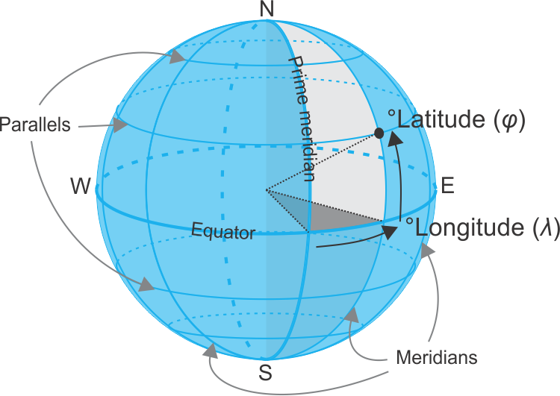
Coordinate Reference System (CRS)
Complication: there are many CRSs
Earliest known: Hipparchus 190-120 BCE
Knowledge of earth and our ability to measure its shape improved over time…
Notes:
So Geospatial Data is a location that is given by a set of coordinates. Anatone WA has specific coordinates associated with its location, a latitude and a longitude. The specific values we use to answer the question of “where” can differ by the coordinate reference system we use.

Slide 7
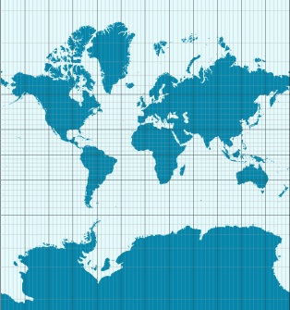
Two Types of Coordinate Reference Systems
Geographic CRS
Projected CRS
Angular units = Degrees
(DMS or DD)
Good for storing data
Cartesian units = Feet or Meters
Good for local/regional mapping and analysis
Notes:
So we have two types of CRS: Geographic and Projected
GCS is good for storing data and has units of degrees
PCS is good for analyzing data and has units of feet or meters
Let’s go through these two types in detail

Slide 8
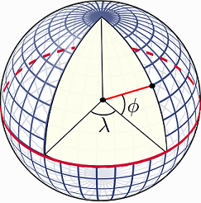
Geographic Coordinate System (GCS)
Latitude and longitude coordinates are an angular system
Latitude: angle between line passing through equatorial plane and line between the point and the center of the earth
Longitude: angle from a reference meridian (line of constant longitude) to a meridian passing through the point
https://rspatial.org/raster/spatial/

Slide 9
Geographic Coordinate System (GCS)
Problem: can’t measure these angles directly
https://rspatial.org/raster/spatial/

Slide 10
Geographic Coordinate System (GCS)
➔ Use a datum, a model of the earth’s shape
2 Most Common:
WGS84 (EPSG: 4326)
Based on satellites, used by cell phones, GPS
Best overall fit for most places on earth
NAD83 (EPSG: 4269)
Based on satellites and survey data
Best fit for USA
Used by many federal agencies (Census)
CRSs are referenced in software by numeric codes, often called EPSG codes
Notes:
The two main datums we work with are WGS84 and NAD83
WGS84, or World Geodesic System 1984, is the most commonly used
NAD83, or North American Datum of 1983, is very similar to WGS84 but is a better fit for the USA
There are also other, more regionally-accurate datums out there.
Those 4 digit numbers you see next to NAD83 is the EPSG code (European Petroleum Survey Group). These codes are often what you’ll be using in R or Python to designate a specific CRS.
One note: sometimes people will say that their data is “in WGS84” or “in NAD83” … which doesn’t mean anything. The coordinates are longitude/latitude relative to the utilized datum.

Slide 11
Map Projections: 3D to 2D
The earth isn’t flat (spoiler), but maps and (most) computer screens are
We use map projections to transform a datum (3D spherical model of the earth) to a 2D plane.
This necessarily introduces distortion, which might impact your maps and spatial analyses!
Notes:
https://cran.r-project.org/web/packages/sf/vignettes/sf7.html

Slide 12

Map Projections: 3D to 2D
Notes:
Image source: https://www.esri.com/arcgis-blog/products/arcgis-pro/education/earth-peel/
Here is our orange… let’s pretend now that it is perfectly spherical

Slide 13
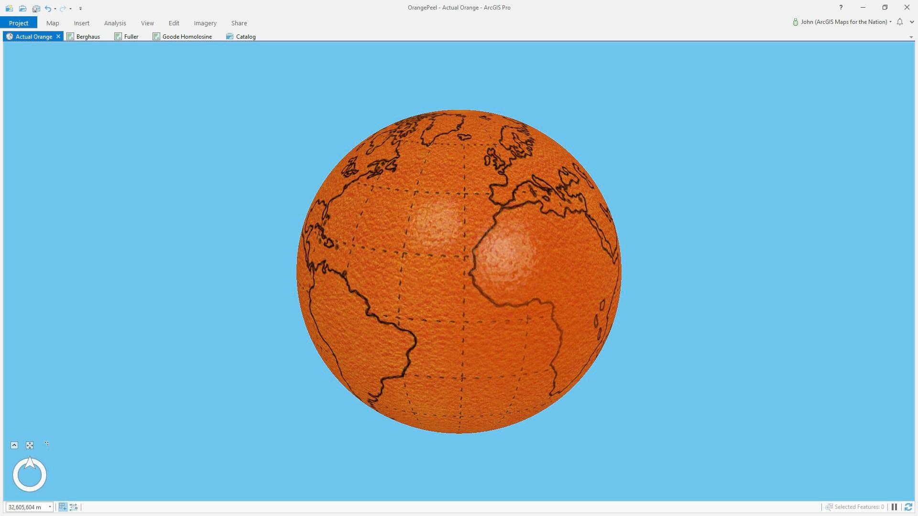
Map Projections: 3D to 2D
Notes:
Image source: https://www.esri.com/arcgis-blog/products/arcgis-pro/education/earth-peel/
Ta-da! And we’ll go ahead and draw all of our continents on here. Now that we have this lovely rendition of earth, we’ll go ahead and peel it.

Slide 14
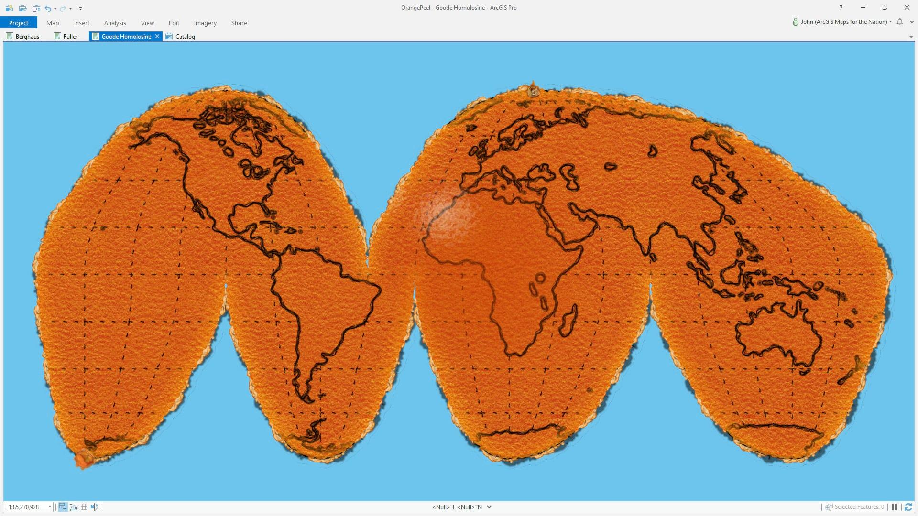
Map Projections: 3D to 2D
Notes:
Image source: https://www.esri.com/arcgis-blog/products/arcgis-pro/education/earth-peel/
And here’s one way to peel it,. This looks pretty similar to the maps you see when you google “world map” or the ones that were hung up in your elementary school classroom. But, the thing is, you can peel an orange multiple other ways

Slide 15
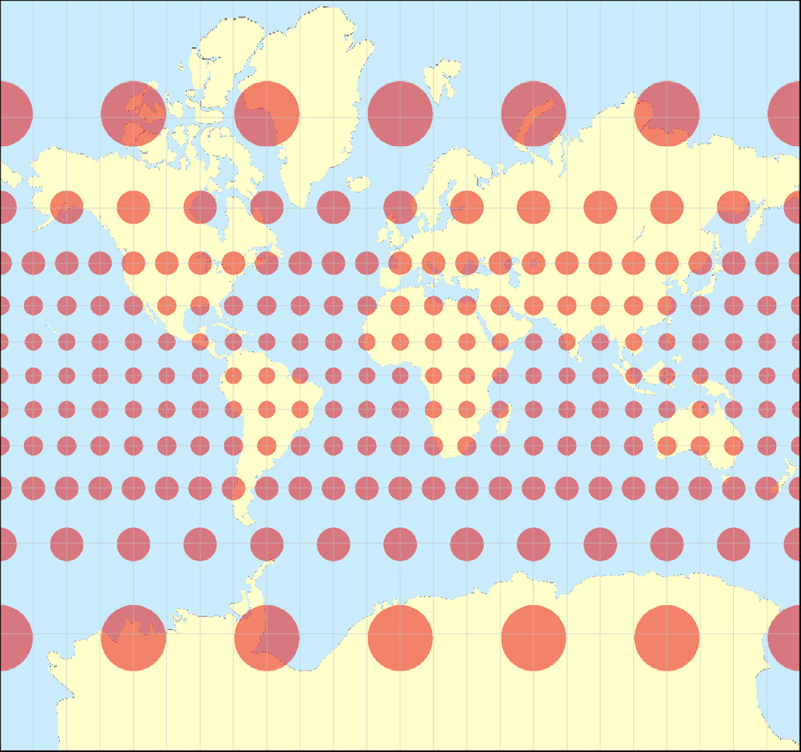
Mercator Projection: Preserves Angles
Notes:
Image source: https://geoawesomeness.com/top-7-maps-ultimately-explain-map-projections/
The Mercator projection that we’re most used to preserves angles, which makes it great for sailing but means that the relative areas of continents aren’t preserved.

Slide 16
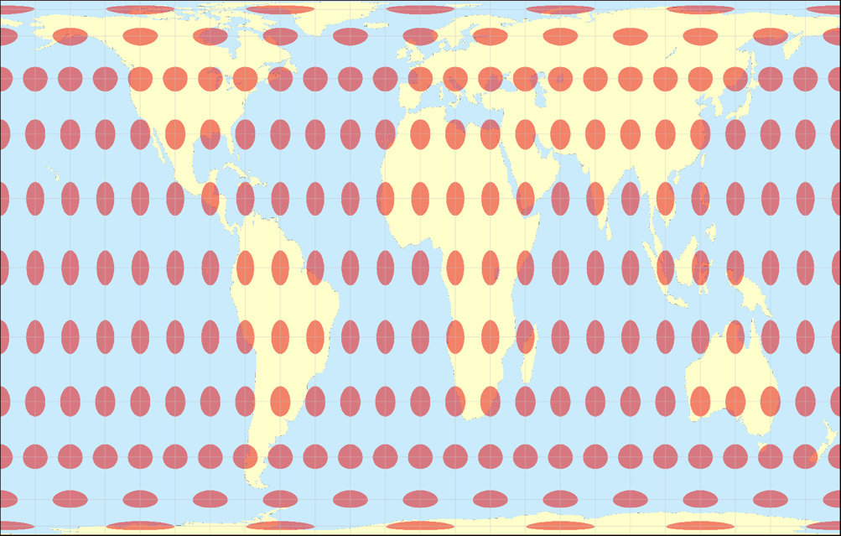
Gall-Peters Projection: Preserves Area Relevant XKCD comic (977)
Notes:
Image source: https://geoawesomeness.com/top-7-maps-ultimately-explain-map-projections/
In contrast, the Gall-Peters projection preserves area, accurately representing the sizes of the various continents but at the cost of distortion in angle and distance

Slide 17
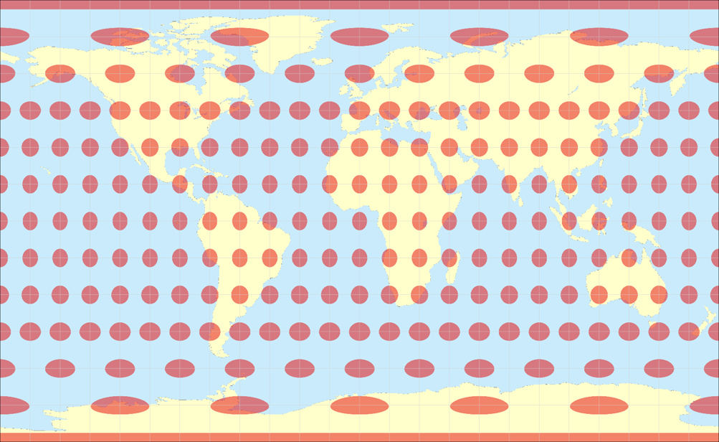
Equirectangular Projection: Preserves Distance
Notes:
Image source: https://geoawesomeness.com/top-7-maps-ultimately-explain-map-projections/

Slide 18
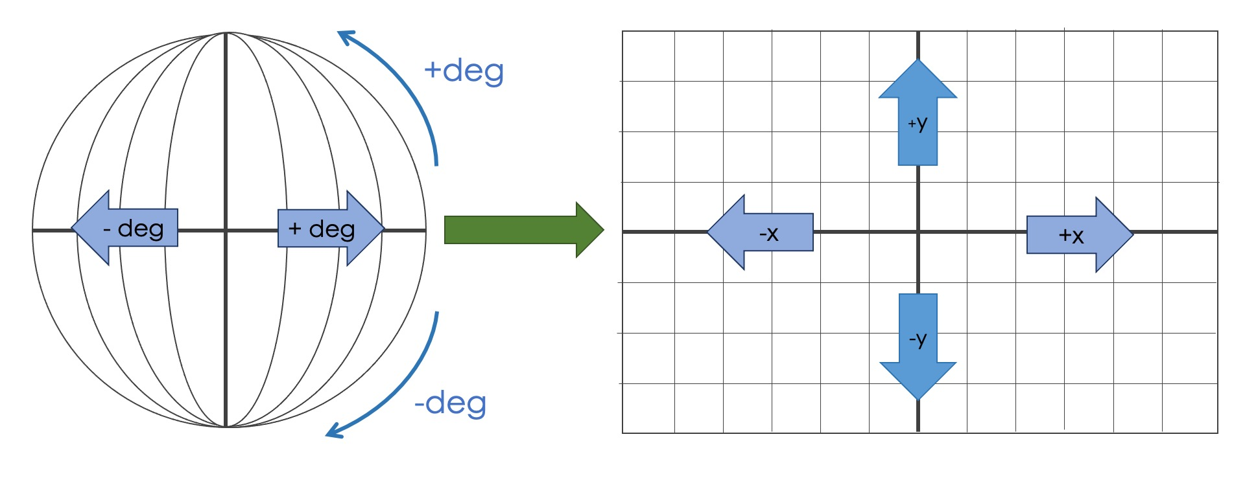
Notes:
Image source: https://geoawesomeness.com/all-map-projections-in-compared-and-visualized/

Slide 19
Projected Coordinate System (PCS)
In short:
Cartography is bonkers
Map projections are needed to go from a 3D datum to 2D coordinates (i.e. making maps)
They introduce distortion in at least area, shape, distance, or direction
Notes:
PCS on the other hand introduce distortion since we’re looking at our locations on a flat plane. But this makes them great for area, shape.. And general measurements of distance. As with GCS, PCS also have some systems that are better for some locations other than others.

Slide 20
Projected Coordinate System (PCS)
Fortunately for us, the sf package in R performs most geometric operations using spherical geometry, so ignores these distortion issues!
We’ll still need to
Know the CRS of your input data
Select the CRS that is most suitable for your data and application (we’ll learn how to transform to other CRSs)
Use a projection for making maps
Notes:
PCS on the other hand introduce distortion since we’re looking at our locations on a flat plane. But this makes them great for area, shape.. And general measurements of distance. As with GCS, PCS also have some systems that are better for some locations other than others.

Slide 21
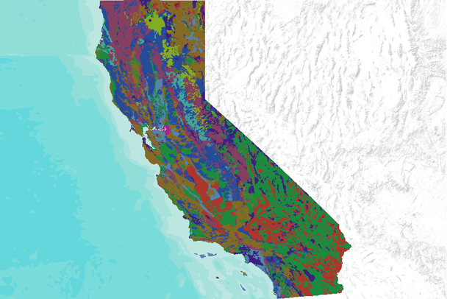
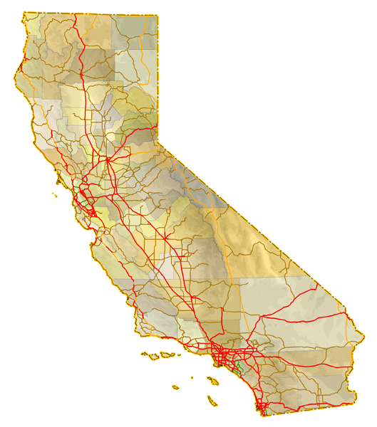
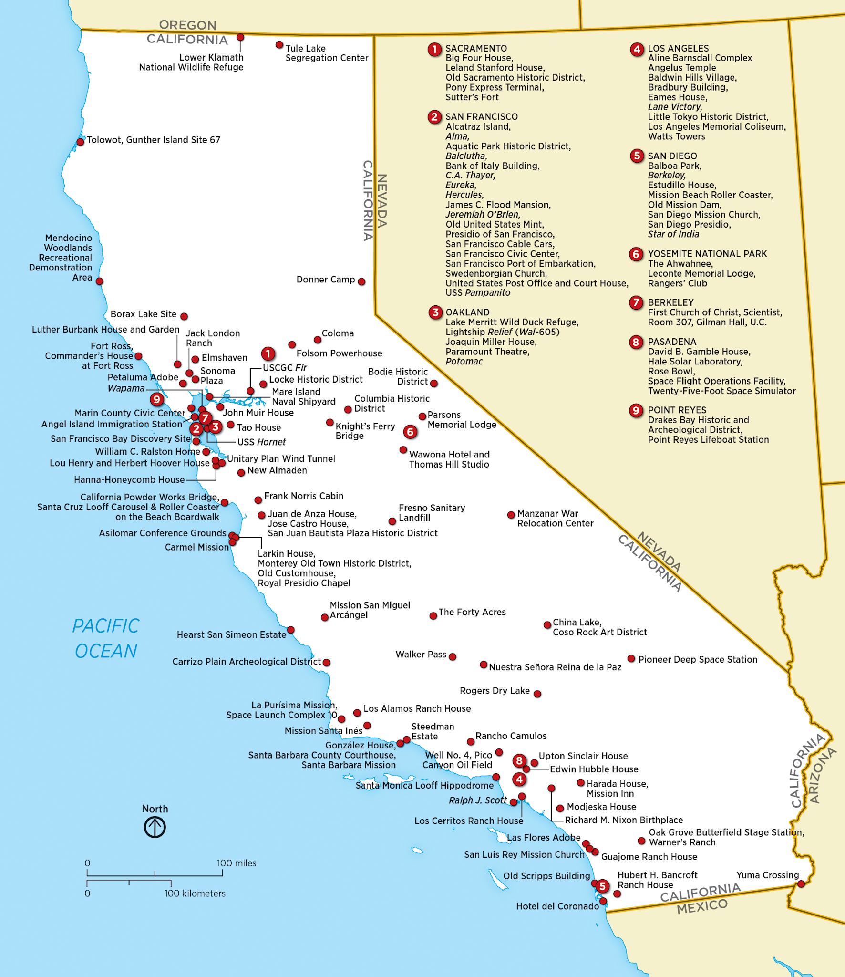
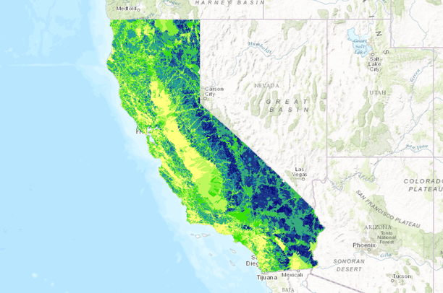
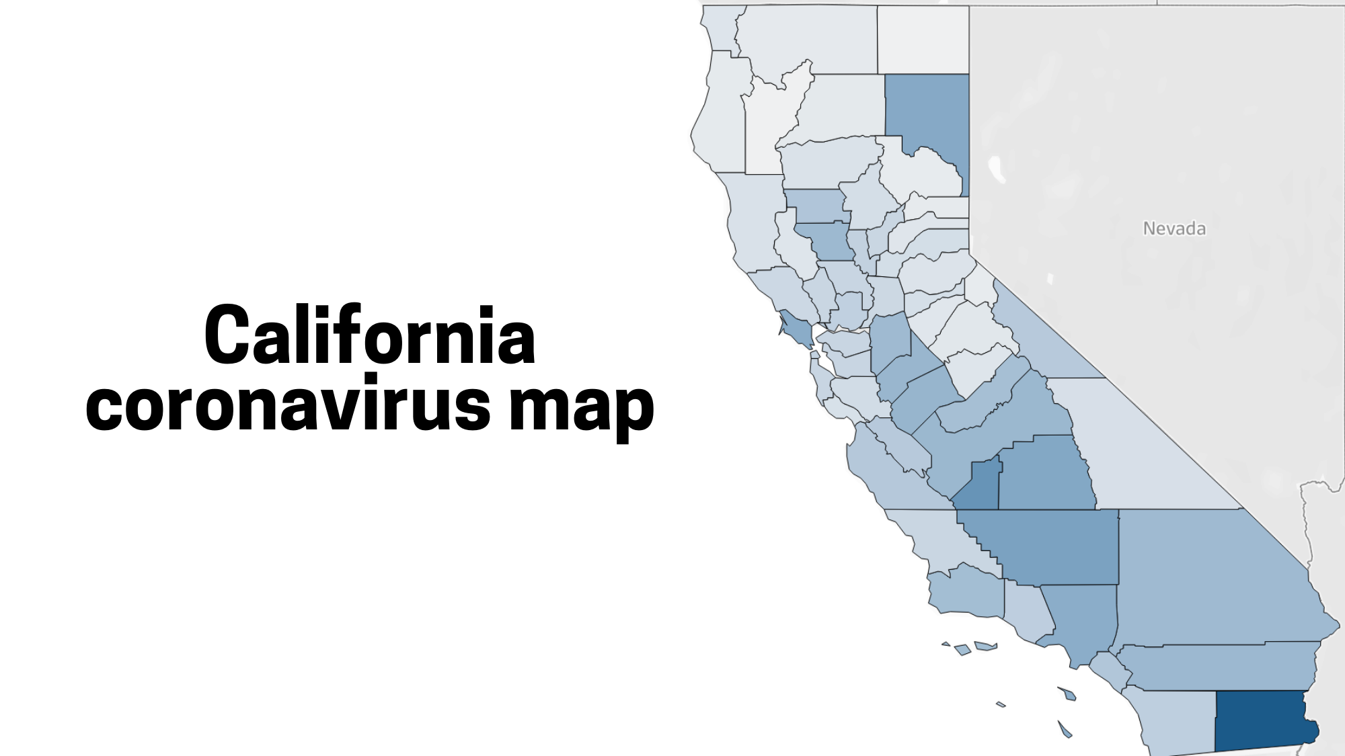
Types of Spatial Data
Notes:
So now that you all have a firm footing in a core concept behind geospatial data, coordinate reference systems, we’ll jump into the different types of spatial data you will encounter.
Img credit: state soil demographic https://databasin.org/datasets/1ff4328039f948529c33e7e71bb9b5fc
Img credit: watershed health https://databasin.org/maps/d20b406693764ce7bcce339539089448
Coronavirus: https://www.mercurynews.com/2020/03/20/map-coronavirus-cases-in-california-by-county/
Roadway: https://www.aaroads.com/california-highways/
Landmark: https://en.wikipedia.org/wiki/List_of_National_Historic_Landmarks_in_California

Slide 22
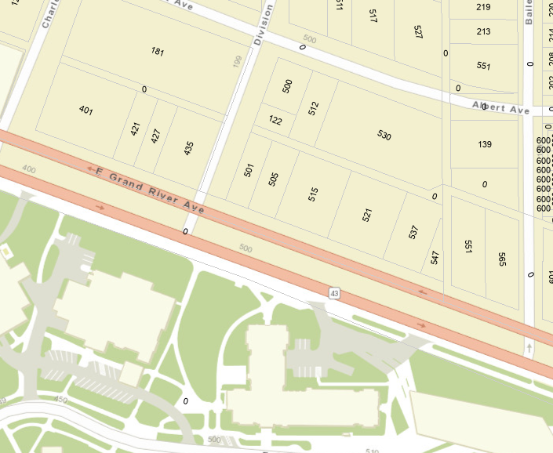
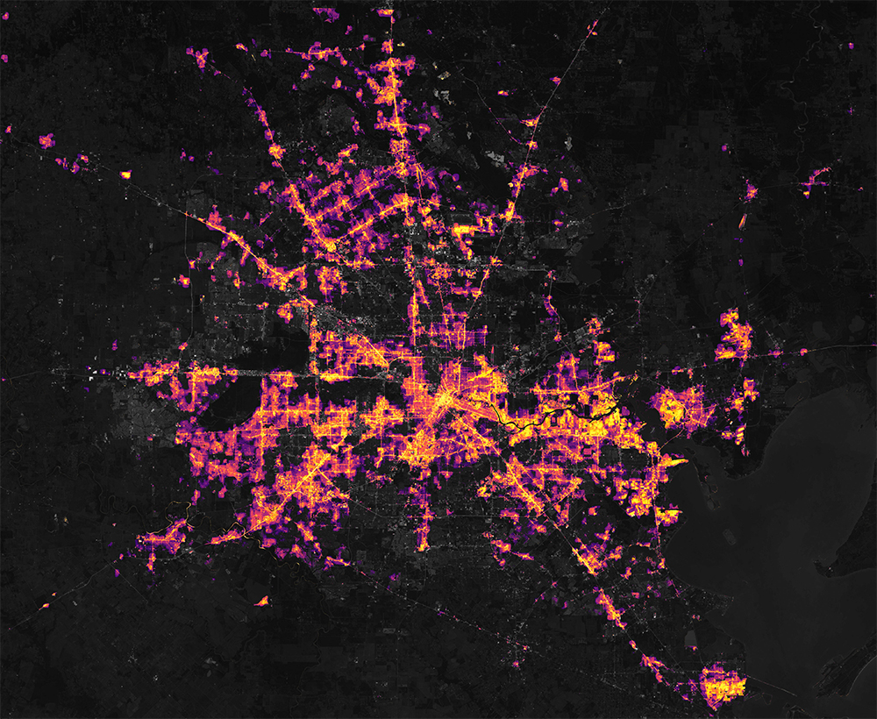
Types of Spatial Data
There are two main spatial data structures:
Vector
Raster
Notes:
Image sources
Nighttime lights raster: https://www.earthdata.nasa.gov/learn/backgrounders/nighttime-lights
East Lansing parcels: http://coel.maps.arcgis.com/apps/webappviewer/index.html?id=076f31109b974149ac3e1c2379aac8d6

Slide 23
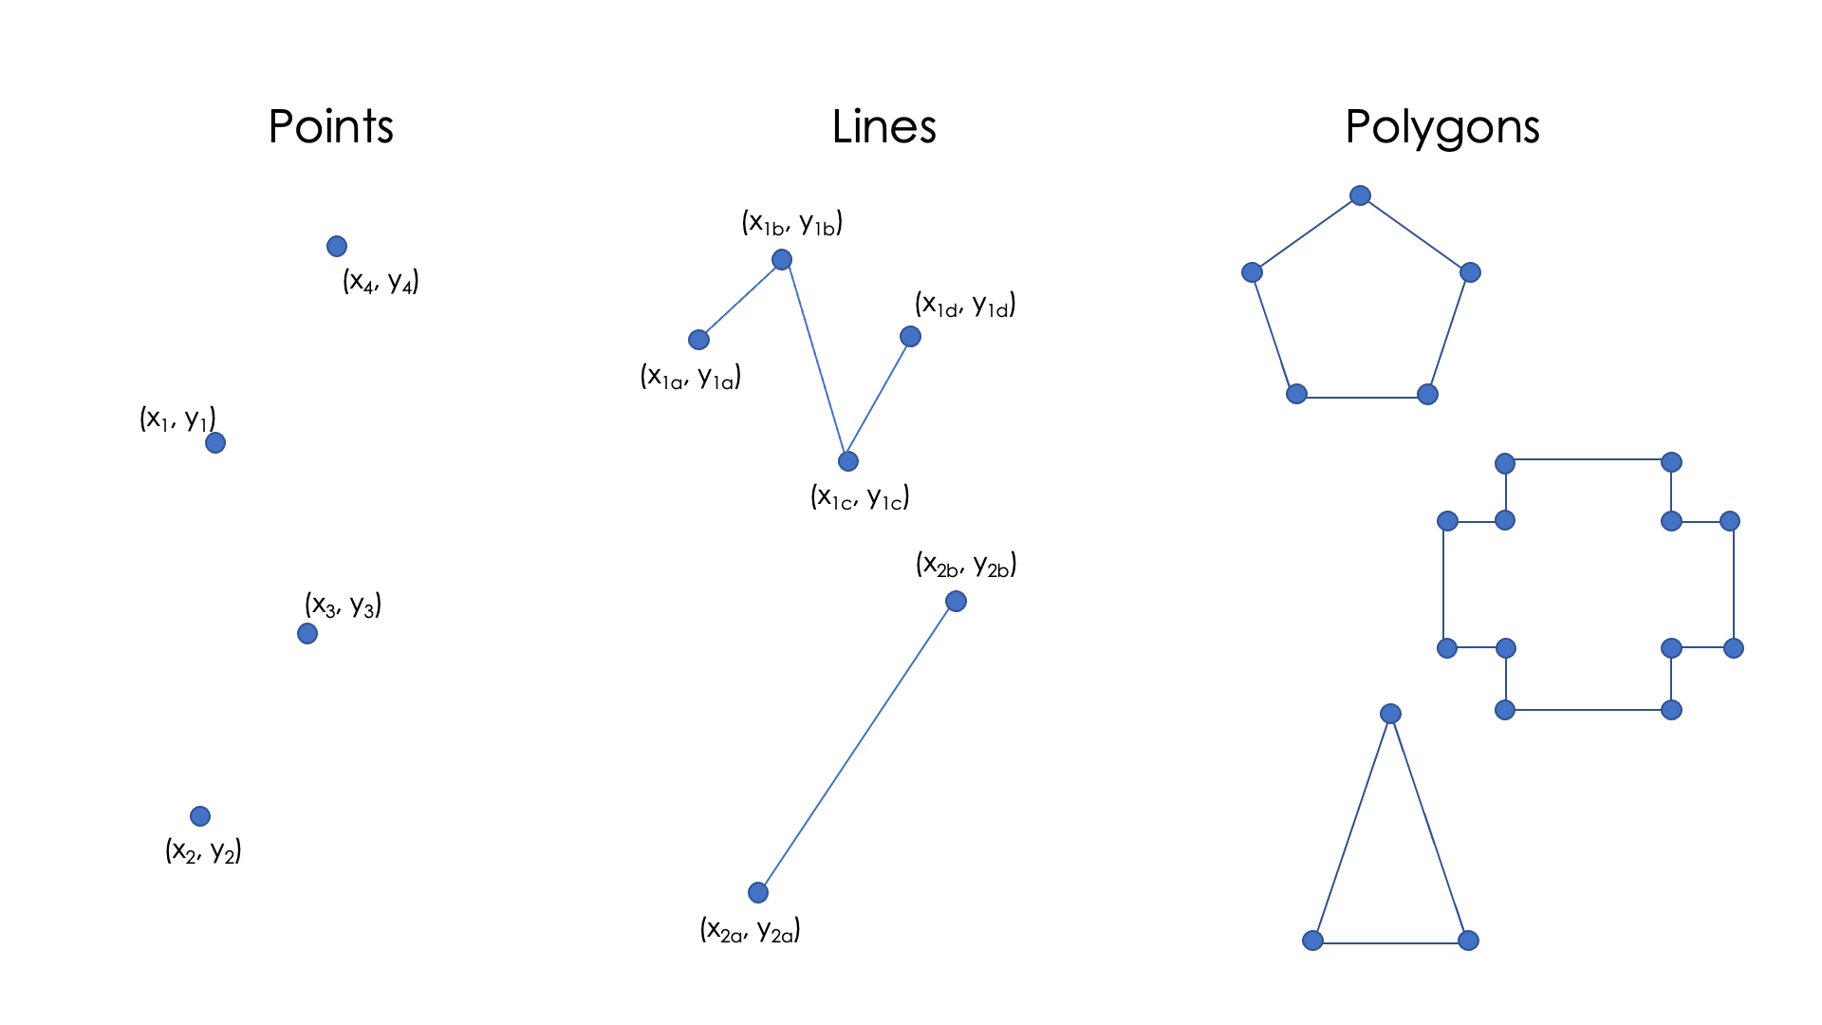
Vector Data: “Connect the Dots”
Notes:
Vector data can be thought of data that you can connect the dots with. This type of data can include points, lines, and polygons.
The geometry of these structures consists of sets of ordered coordinate pairs (x,y).

Slide 24
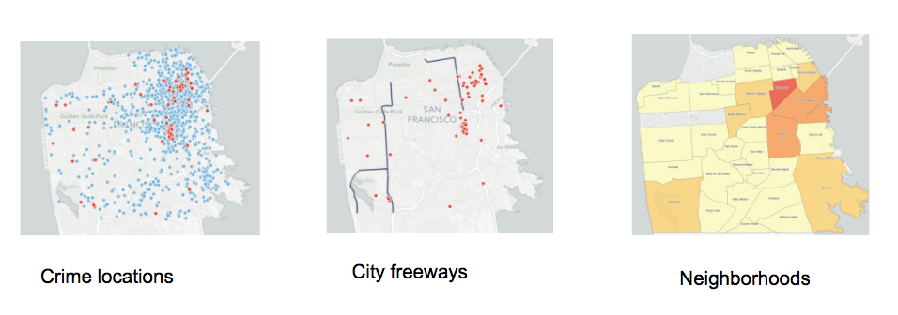
Vector Data: Points, Lines, and Polygons
Notes:
Each of these geometry types can be for a different type of information. Points could be great for showing us where crimes have occurred historically. Lines could show us the location and length about where freeways are in the city. Polygons could help us show different information about different neighborhoods.

Slide 25
Vector Data with Attributes
Each row represents one geospatial feature
ID
1
Notes:
We’ll now briefly talk about what this vector data looks like when you open it up.
You might get something like the table you see on the right side of the screen. Each row represents one geospatial feature. So for our second attribute we have the ID number 2, the plot size 20, vegetation type, and a vegetation class of deciduous. Those additional information I just rattled off to you like the plot size, are attributes. These help describe our features.
Furthermore, each of these features have an associated geometry or geometry collection. So in our first table our geometry is a point,
One last thing about vector data-- each group of features is called a layer. So you could have all three of these data, and each dataset would be its own layer.
I’ll pause for a moment for any questions. Feel free to drop them in the chat or unmute to ask your question.

Slide 26
Vector Data with Attributes
Each row represents one geospatial feature
Attributes describe the features (fields or columns)
ID | City | Population
1 | Detroit | 645,658
Notes:
We’ll now briefly talk about what this vector data looks like when you open it up.
You might get something like the table you see on the right side of the screen. Each row represents one geospatial feature. So for our second attribute we have the ID number 2, the plot size 20, vegetation type, and a vegetation class of deciduous. Those additional information I just rattled off to you like the plot size, are attributes. These help describe our features.
Furthermore, each of these features have an associated geometry or geometry collection. So in our first table our geometry is a point,
One last thing about vector data-- each group of features is called a layer. So you could have all three of these data, and each dataset would be its own layer.
I’ll pause for a moment for any questions. Feel free to drop them in the chat or unmute to ask your question.

Slide 27
Vector Data with Attributes
Each row represents one geospatial feature
Attributes describe the features (fields or columns)
Each feature has an associated geometry or geometry collection
ID | City | Population
1 | Detroit | 645,658
Notes:
We’ll now briefly talk about what this vector data looks like when you open it up.
You might get something like the table you see on the right side of the screen. Each row represents one geospatial feature. So for our second attribute we have the ID number 2, the plot size 20, vegetation type, and a vegetation class of deciduous. Those additional information I just rattled off to you like the plot size, are attributes. These help describe our features.
Furthermore, each of these features have an associated geometry or geometry collection. So in our first table our geometry is a point,
One last thing about vector data-- each group of features is called a layer. So you could have all three of these data, and each dataset would be its own layer.
I’ll pause for a moment for any questions. Feel free to drop them in the chat or unmute to ask your question.

Slide 28
Vector Data with Attributes
Each row represents one geospatial feature
Attributes describe the features (fields or columns)
Each feature has an associated geometry or geometry collection
A group of features is called a layer
ID | City | Population
1 | Detroit | 645,658
2 | Lansing | 113,592
3 | East Lansing | 47,427
Notes:
We’ll now briefly talk about what this vector data looks like when you open it up.
You might get something like the table you see on the right side of the screen. Each row represents one geospatial feature. So for our first attribute we have the ID number 1, followed by the city name of Detroit, and its population of 645,658 in 2023. That information, what we typically think of as variables in our dataset that correspond to the feature, are its attributes.
Furthermore, each of these features have an associated geometry or geometry collection. Here, each of our geometries is a polygon.
One last thing about vector data-- each group of features is called a layer. So you could have all three of these data, and each dataset would be its own layer.

Slide 29
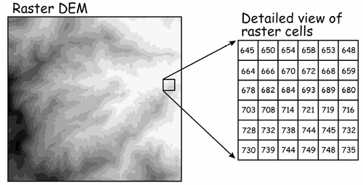
Raster Data: regular grids describing continuous phenomena
A location is divided into rectangular cells
Cells have regular size (e.g. 20m x 20m)
Grid has a fixed number of rows and columns
Each cell has a value that represents the attribute of interest (e.g. elevation)
Notes:
Now let’s go to Raster data! Do you notice anything about this image that seems different from what we had looked at for vector data?
RIght, so raster data looks more continuous. Our data aren’t defined by geometries--- rather, it’s like this quilt of little squares, each square holding a value. These squares could be something like 20 by 20 meters, and each one could hold information such as elevation.

Slide 30
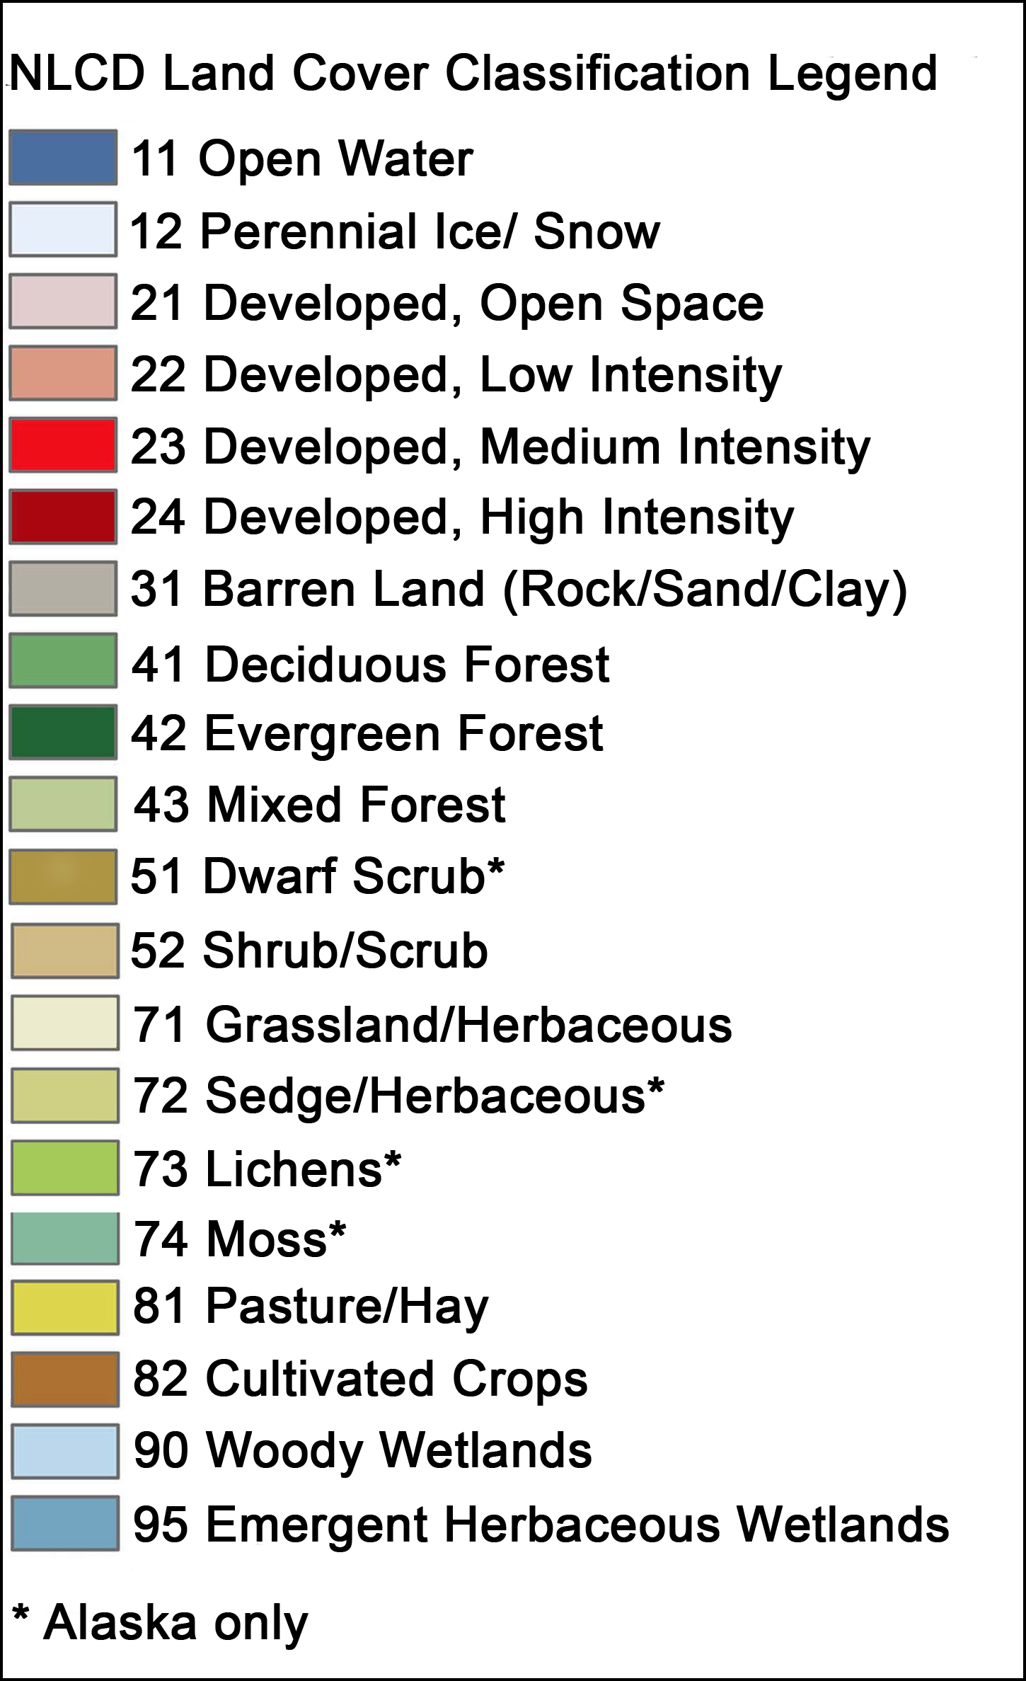
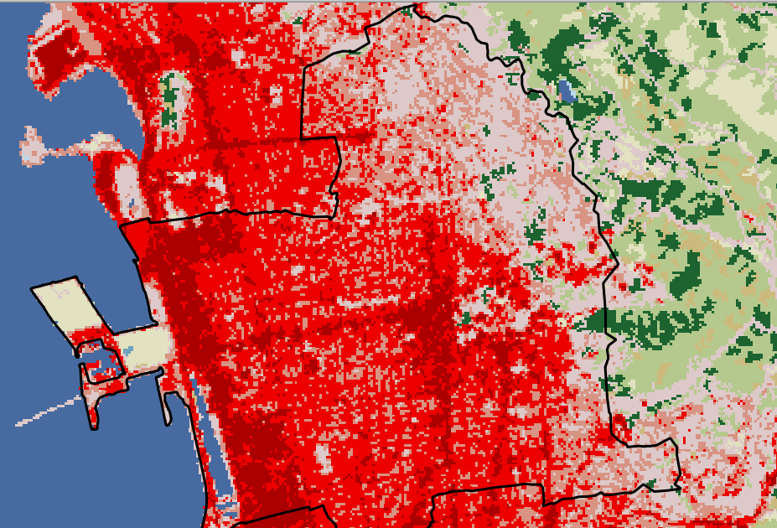

Categorical Raster Data
30m pixels
Notes:
Source: National Land Cover Database (NLCD) https://www.usgs.gov/centers/eros/science/national-land-cover-database

Slide 31
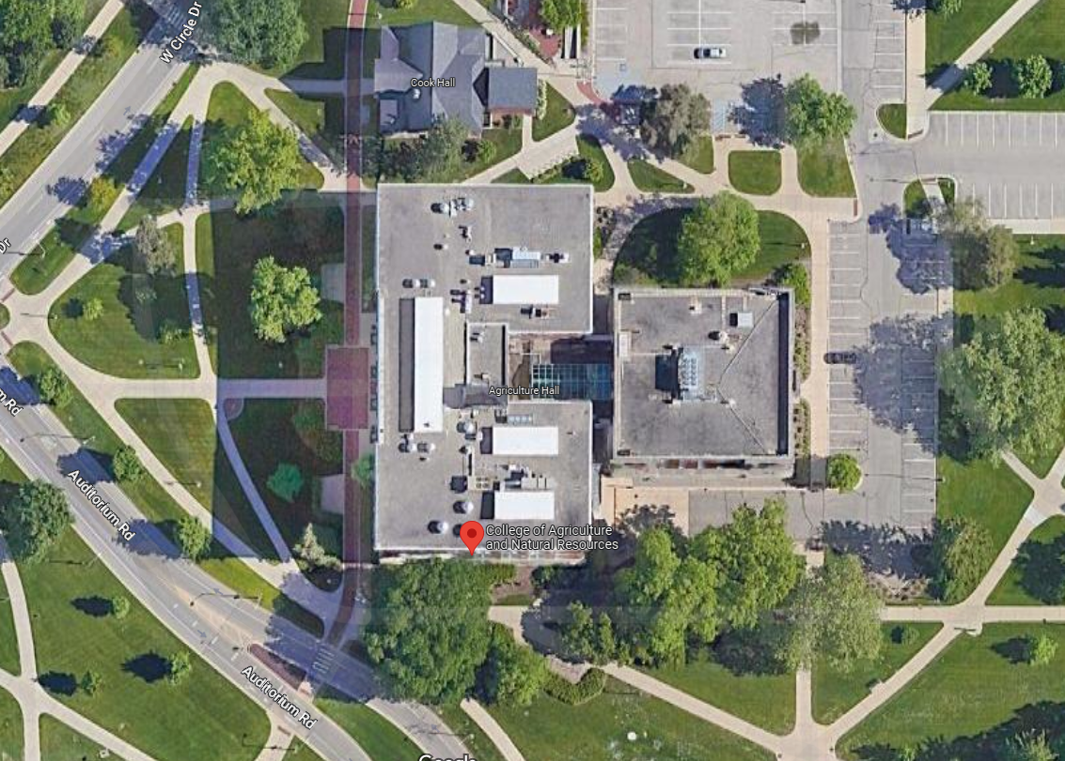
Satellite Imagery Data are Raster Data
Notes:
Source: National Land Cover Database (NLCD) https://www.usgs.gov/centers/eros/science/national-land-cover-database

Slide 32
Satellite Imagery Data are Raster Data
Note: aerial or satellite imagery and other remotely-sensed data are commonly used as sources of vector data
I.e. the Ag Hall building footprint can be digitized and converted to vector data.
Notes:
Source: National Land Cover Database (NLCD) https://www.usgs.gov/centers/eros/science/national-land-cover-database

Slide 33
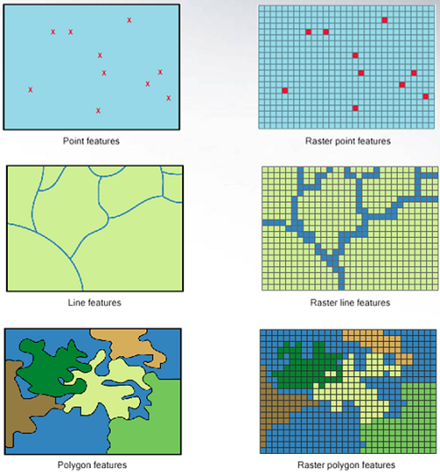
Vector vs. Raster
Vector data are better for discretely bounded data
e.g. political boundaries, waterways, parcels
Raster data are better for continuous data
e.g. temperature, rainfall, elevation, night lights
Image: http://gsp.humboldt.edu/

Slide 34
Common Spatial File Formats
Vector
Raster
Shapefile (.shp)
GeoJSON, JSON
KML
GeoPackage
GeoTIFF (.tif)
netCDF
DEM
Notes:
Now these two datasets come in different file formats, so you’ll know what it is before you pull it in for whatever GIS software you’re using. Some common ones I use are shapefile and geojsons for vector data, and geotiffs for raster data.

Slide 35
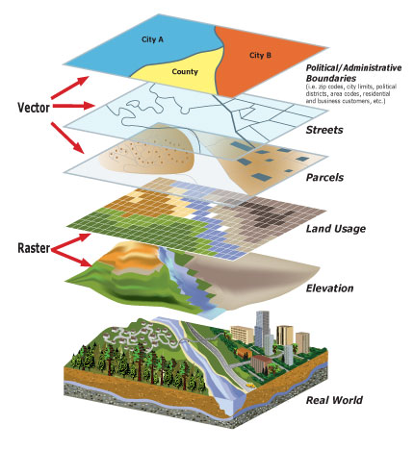
Georeferencing
Data layers in the same coordinate reference system can be linked dynamically to explore associations and build complex models of the real world
Can link rasters and vectors
Notes:
Although these two types of data look different, and come in different formats, you can still use a combination of raster and vector data to answers questions that you’re probably aiming to answer through your own work.

Slide 36
The Power of Spatial Data
What does this mean for us?
Add vector data to create maps of features and attributes
Combine, split, and perform operations on vectors
Extract raster values for the vector features, across space and/or time
Notes:
Although these two types of data look different, and come in different formats, you can still use a combination of raster and vector data to answers questions that you’re probably aiming to answer through your own work.

Slide 37
The Power of Spatial Data
A recent workflow of mine:
Link vector parcel data for two Northern CA counties to water billing records
Extract raster temp/precip data for each parcel/billing cycle
Read in vector data of pricing zones, calculate distance of each parcel to boundary
Use spatial regression discontinuity models
Make a bunch of maps

